Slide 1


B.SC. FINAL PROJECT · DIGITAL MEDICAL TECHNOLOGIES · HIT
Predicting Infections during hospitalization among postsurgical patients
A multimodal ML + NLP framework for early infection risk
Tal Meillet
Hodaya Yasayev Klenter
&
I.D. 209966019
I.D. 323856757
Academic supervisors: Dr. Ayelet Butman · Dr. Revital Marbel
Clinical supervisor: Dr. Manor Shpriz- Assuta Ramat HaHayal

Slide 2
CLINICAL BACKGROUND
Hospital-acquired infection: the clinical problem
2 - 5 %
3.5 - 10 B$
0
of operations develop a SSI^{[1]}
excess annual cost from SSIs in the US alone ^{[2]}
national SSI surveillance programs in Israel ^{[3]}
Today- detection of infection is usually confirmed only once it is already apparent.
[1] World Health Organization. Global Guidelines for the Prevention of Surgical Site Infection, 2nd ed. Geneva: WHO, 2018.
[2] Chakraborty A, et al. "Development and evaluation of machine learning models for the identification of surgical site infection in electronic health records." Surgical Infections 26, no. 7 (2025): 474.
[3] Najjar Debbiny R, et al. "Healthcare-associated infection prevention and control practices in Israel: results of a national survey." BMC Infectious Diseases 22 (2022): 739.
02

Slide 3
The research gap
01
02
03
Structured models often lack external validation^{[4][5]}
Text adds value - but representation matters^{[6][7]}
Hebrew multimodal SSI prediction remains unexplored^{[8]}
Research question:
To what extent can a multimodal machine learning framework, combining structured tabular EHR data with unstructured narrative clinical text, predict the risk of postoperative infection at the end of the surgical procedure among surgical patients at Assuta Ramat HaHayal, compared with a single-modality tabular model?
[4] Ndjonko LCM, et al. "Evaluating predictive performance and generalizability of traditional and artificial intelligence models in predicting surgical site infections post-spinal surgery: a systematic review." Spine Journal 26, no. 2 (2026): 280–291.
[5] Cui Y, Shi X, Wang Q, et al. "Artificial intelligence-based prediction model for surgical site infection in metastatic spinal disease: a multicenter development and validation study." International Journal of Surgery (2025).
[6] Bonde A, et al. "Assessing the utility of deep neural networks in detecting superficial surgical site infections from free text health record data." Frontiers in Digital Health 5 (2024): 1249835.
[7] Verberk JDM, et al. "The augmented value of using clinical notes in semi-automated surveillance of deep surgical site infections after colorectal surgery." Antimicrobial Resistance & Infection Control 12 (2023): 117.
[8] Saban M, et al. "Identifying diabetes related-complications in a real-world free-text electronic medical records in Hebrew using natural language processing techniques." Journal of Diabetes Science and Technology 19, no. 4 (2025): 99-–1007.
03

Slide 4
FROM THE PROJECT PROPOSAL
Project goals
1
Develop a data-driven ML model to predict the risk of SSI during hospitalization.
2
Enable early identification of elevated-risk patients.
3
Identify key variables associated with infection risk.
4
Evaluate the contribution of these variables to prediction performance.
5
Compare the performance of different predictive models and select the most accurate and reliable approach.
Final scope: postoperative SSI prediction at the end of surgery.
04

Slide 5
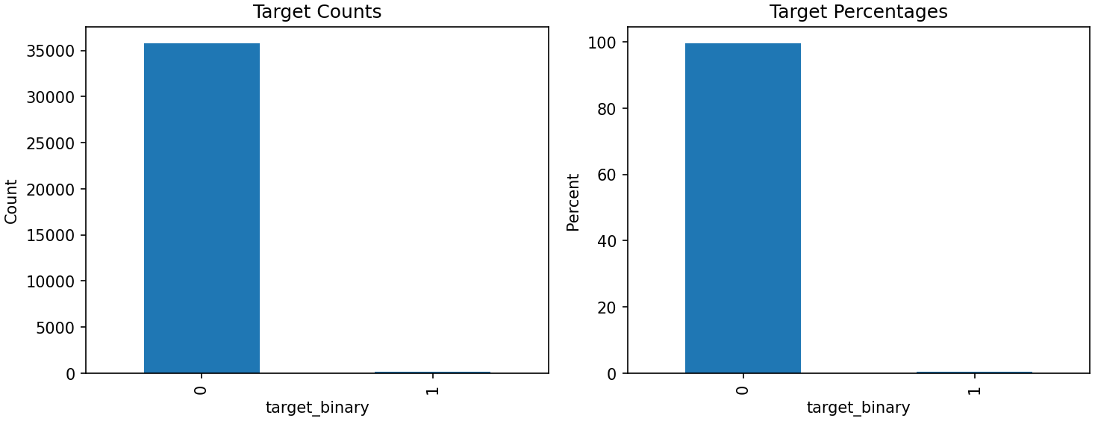
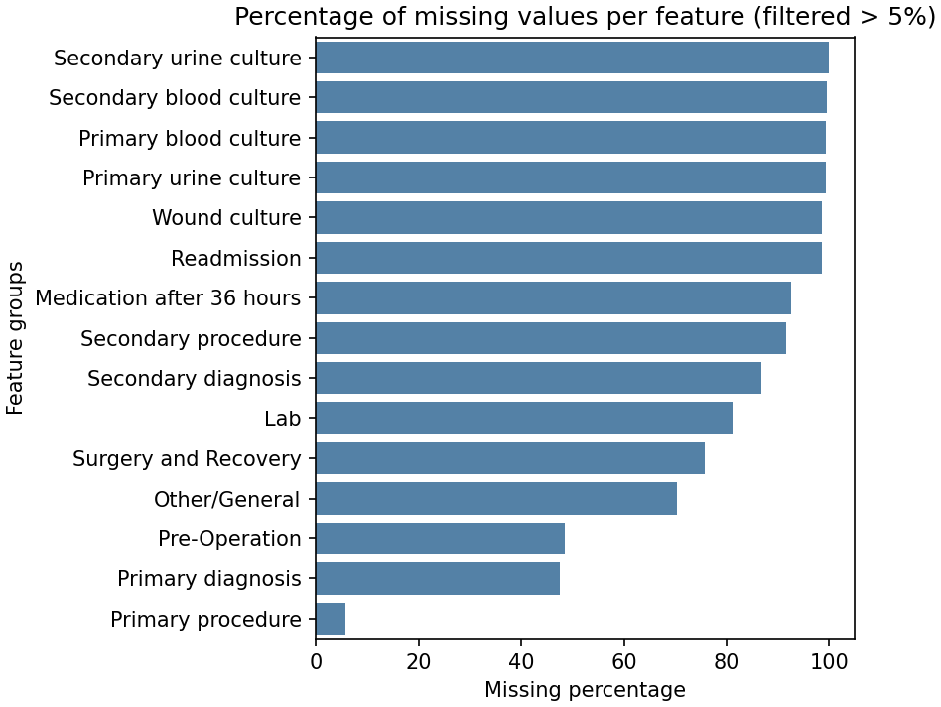
DATA
The data: Assuta Ramat HaHayal EHR
35,925
surgical events
141 · 0.39%
Positive SSI
244 → 97
Columns after
cleaning
Figure 2- the outcome is very rare
Figure 3- missingness by feature group
05

Slide 6
METHOD
From raw export to a risk model
Stage 1-2
Stage 3
Stage 4
Stage 5
Exploratory analysis of the raw export and of the infected subgroup
Cleaning, cohort restriction, prediction-window enforcement
EDA repeated on the cleaned dataset
Hebrew text processing: comparison of three text models
Stage 6
Stage 7
Stage 8
Feature engineering; locked train/test split: out-of-fold text score
Pre-modelling: prototype aggregation, encoding, imputation
Modelling: balancing, tuning, threshold selection, calibration, evaluation, SHAP
06

Slide 7
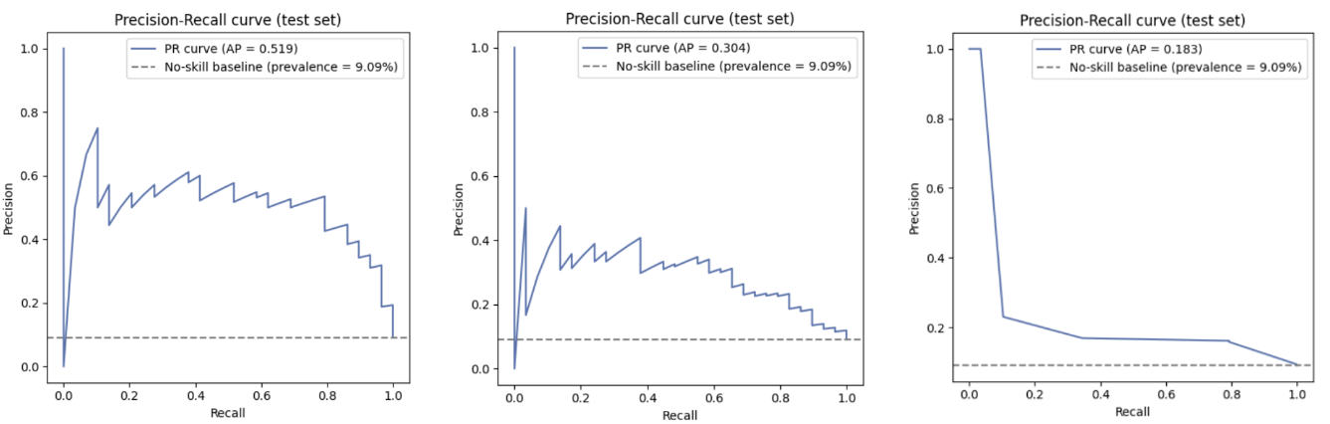
FIRST COMPARISON
Comparing the text models
Method | ROC-AUC | PR-AUC (AP) | Precision | Recall
TF-IDF + logistic regression | 0.933 | 0.519 | 0.577 | 0.517
TF-IDF + XGBoost | 0.821 | 0.304 | 0.286 | 0.069
Llama 3.3:70b, prompted | 0.701 | 0.183 | 0.169 | 0.345
Precision–recall by representation
Evaluated on a rebalanced 319-note split (29 positive), built to rank the three representations
The simplest model won decisively over a 70-billion-parameter LLM
07

Slide 8
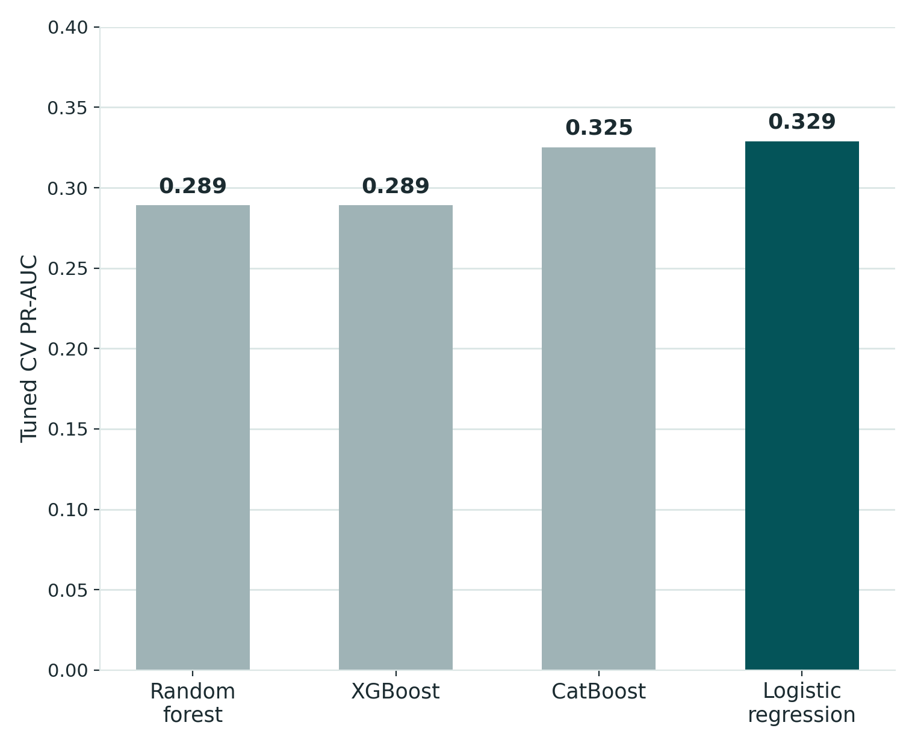
SECOND COMPARISON
Comparing the tabular models
Model | Tuned CV PR-AUC | Tuning runtime (s)
Logistic regression - locked | 0.329 | 11
CatBoost | 0.325 | 1,547
XGBoost | 0.289 | 31
Random forest | 0.289 | 86
Tuned CV PR-AUC by model
Takeaway
Logistic regression and CatBoost were a near-tie on
CV PR-AUC. The tie was resolved for the cheaper, more interpretable SMOTE-balanced linear model.
08

Slide 9
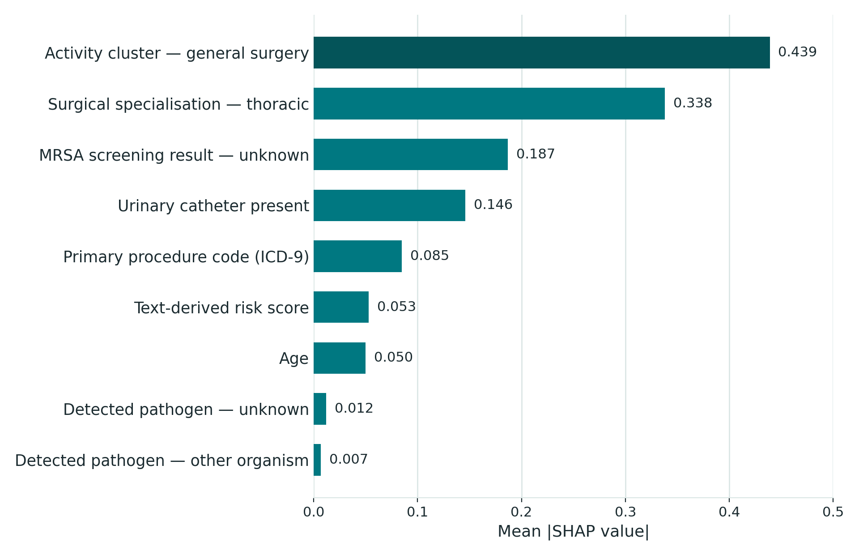
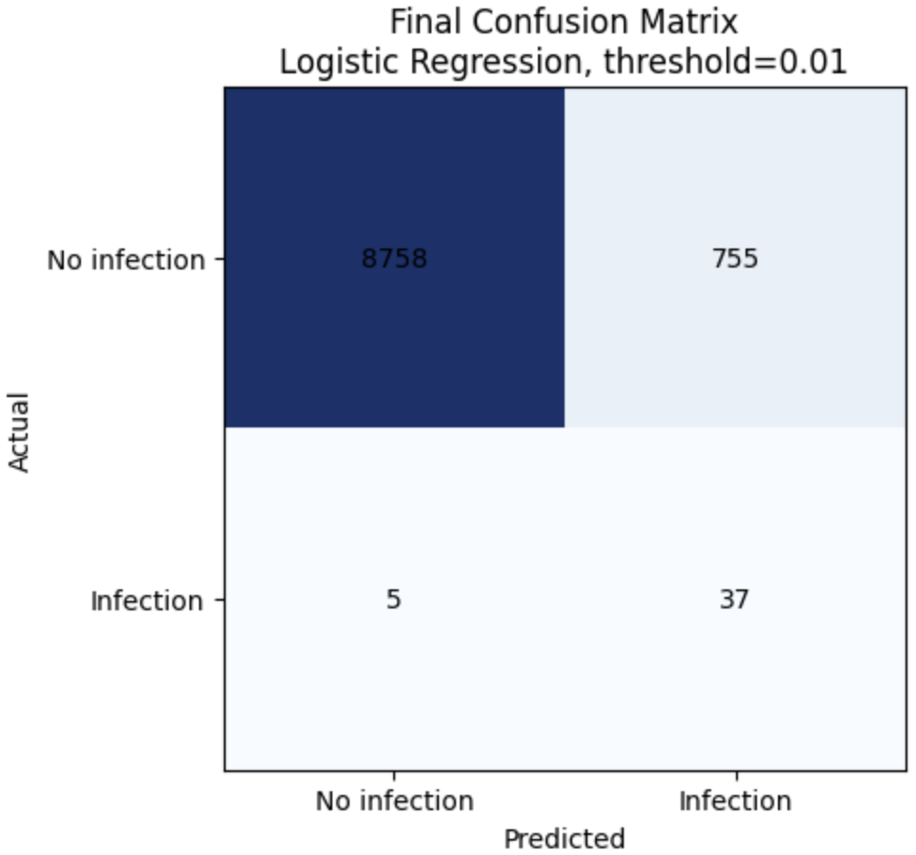
Final model performance
What drives the score (SHAP)
Confusion matrix - 9,555 events, 42 infections
Clinical workload: 82.9 alerts per 1,000 procedures.
09

Slide 10
Conclusions
1
Hebrew clinical narrative carries genuine infection
2
High discrimination does not mean high precision
3
The prediction point is a clinical decision, not a technical parameter
4
A single scalar may be too narrow a channel for multimodal integration
5
Leakage control has to be designed into the pipeline
Objectives: 4 achieved / 1 partially achieved- early identification demonstrated retrospectively, not prospectively.
10

Slide 11
Limitations
Statistical power
A compressed feature set
Pre-operative by clinical defenition
42 positive cases in the test set.
266 features were reduced to 20 before modelling.
No patient-level timestamp
Possible cohort artefact
Limited post-discharge follow-up
Performance varies by subgroup
Four zero-infection activity clusters were excluded
Infections outside Assuta missed
Large subgroup differences
11

Slide 12
RECOMMENDATIONS
Directions for further work
Richer text integration
Hebrew Transformer
Subgroup-specific thresholds
Beyond one scalar score
Domain-adapted, GPU-trained
Especially thoracic surgery
Prospective evaluation
Dynamic risk model
Hospital dashboard
On newly admitted patients
Continuously updating
Surface score in workflow
12

Slide 13
Thank you!
Tal Meillet & Hodaya Yasayev Klenter
B.Sc. Digital Medical Technologies, Holon Institute of Technology
Special thanks to:
Dr. Manor Shpriz- Clinical Supervisor, Assuta Ramat HaHayal
Galina- Infection Control Nurse, Assuta Ramat HaHayal
David Falka- System Team, Information Systems Division, Assuta

